Slide 1
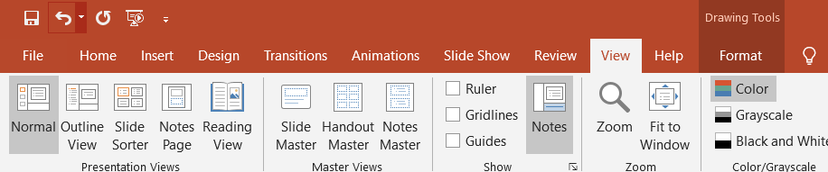
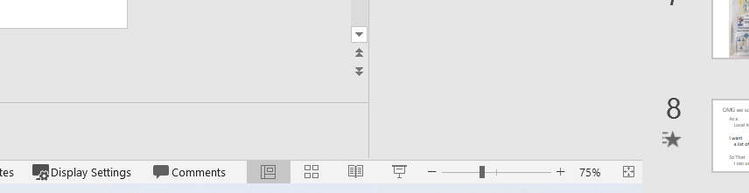
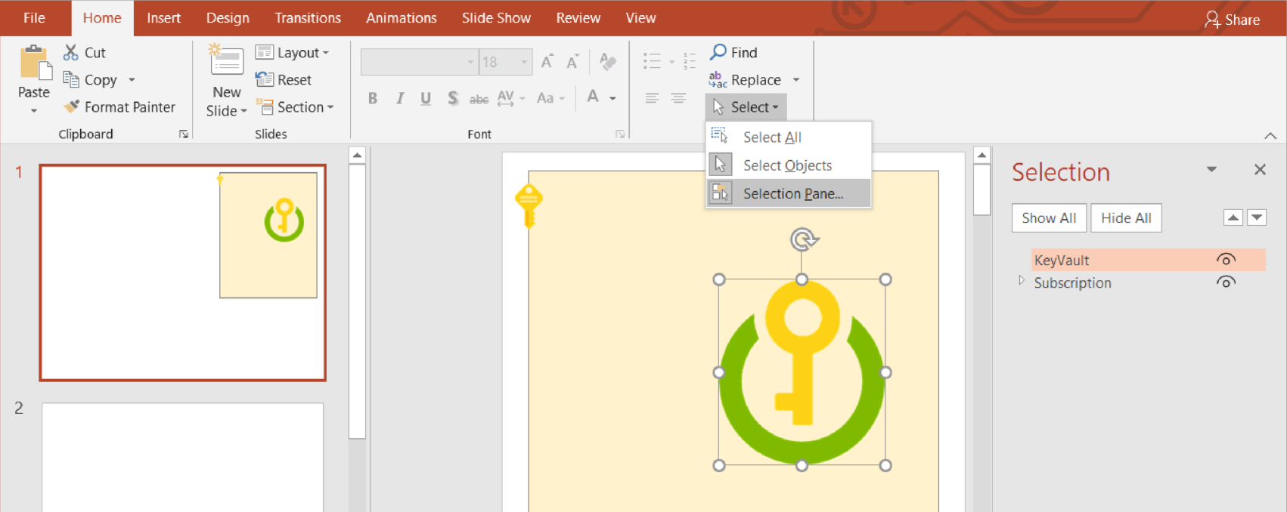

Recommendations for how to use this file
This isn’t a presentation – it’s a file for you to edit
Create your own copy of this file
Set the View to Normal if it isn’t already
Images in the gutter. You will be creating a “Cloud” out of the images in the gutter (the grey area around the slides): You can click and drag them on to the slide.
Zoom rather than resize. The images on the following slides have been scaled to fit with each other. Rather than changing the size of any of them, we suggest you zoom in when they are too small. For Windows users, you can hold down the Control Key and scroll your mouse wheel to zoom. Both Windows and Mac users may find pinching on their trackpad works too. PowerPoint’s manual zoom control is in the bottom right of the window:
Avoid Copy+Paste. Azure for Normal People leans heavily on a metaphor of how painful it is to manually do the same thing over and over again. To get the intended experience: avoid Copy+Paste. You shouldn’t need it - there are enough copies of the images in the gutter to complete the workshop without creating more with Ctrl-C, Ctrl-V.
You may find the Object Selection Pane useful to have open. Use the little triangles to collapse groups of objects
Selecting an object and pressing the arrow keys will nudge it around
You can Group Objects to make them easier to move around as a set. Select the objects and press Ctrl+G. To ungroup, select the group and press Ctrl+Shift+G
If you keep accidentally scrolling to this slide, delete it
This text is in the gutter

Slide 2









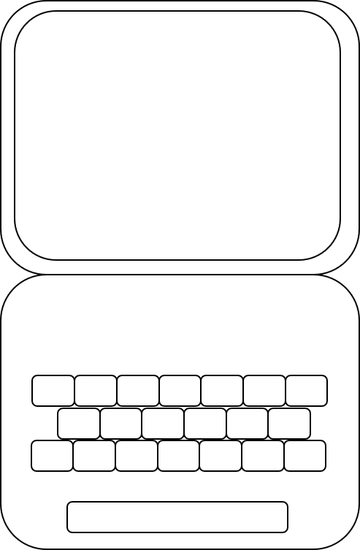
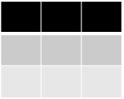








Hi there! This is just a spacer to help you not scroll off the slide
bhas
role
WebApp Instances:
WebApp Size:
Storage Account:
Key Vault:
Function:
name
resource
prod
role
Building Height Attribute Service
name
name
resource
?
?
?
?
name
Application
Application
Application
name
name
name
name
Table
Queue
// stg1ad4g7
// stg26ea39
// stg3bb28c7
// stg49a5e3f
Table
Table
Table
name
name
Key Vault
Key Vault
Key Vault
Key Vault
Azure DevOps
env name
env name
env name
env name
Compile
Test
Package
BHA Application
Height Team Project
Infrastructure
BHA
Compile
Test
Package
name
prod
Azure DevOps
Hi there! This is just a spacer to help you not scroll off the slide

